Slide 1
The Marketing Mix Part 2: Services
Dr Jenny Lloyd
Associate Professor
Term 1

Slide 2
Session objectives
Outline the nature and characteristics of services, and associated management challenges
Discuss the (extended) services marketing mix (7Ps)
Clarify the key elements involved in marketing services
Discuss the extent to which services are different from goods
Illustrate the concept and potential applications of service ‘blueprinting’

Slide 3



What is a service?
A service is an intangible product involving a deed, a performance or an effort that physically cannot be possessed. (Dibb and Simkin 2013)

Slide 4
Nature of services (adapted from Hoffman and Bateson 1997)
Intangibility
Inseparability
Perishability
Lack of ownership
Heterogeneity
Client-based Relationships

Slide 5
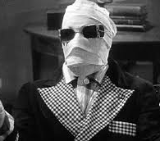
Intangibility (adapted from Hoffman and Bateson 1997)
Difficult for the customer to evaluate
Customer does not take physical possession
Difficult to advertise and display
Difficult to set and justify prices
Service process is not usually defended by patents

Slide 6
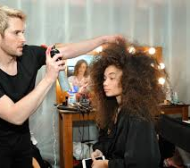
Inseparability of production and consumption (adapted from Hoffman and Bateson 1997)
Service provider cannot mass produce services
Customer must participate and comply in production
Other consumer can affect service outcomes
Services are difficult to distribute and replicate

Slide 7
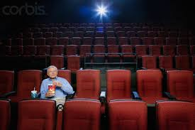
Perishability (adapted from Hoffman and Bateson 1997)
Services cannot be stored
Very difficult to balance supply and demand
Unused capacity is lost forever
Demand may be very time sensitive

Slide 8

Heterogeneity (adapted from Hoffman and Bateson 1997)
Service quality is difficult to control
Difficult to standardize service delivery

Slide 9

Lack of ownership (adapted from Hoffman and Bateson 1997)
There is no transfer of ownership
Access to service is often time limited

Slide 10

Client-based relationships (adapted from Hoffman and Bateson 1997)
Success depends upon satisfying and keeping customers over the long term
Generating repeat business is challenging
Relationship building becomes critical
Service providers are critical to delivery
Requires high levels of training

Slide 11
Extended marketing mix for services, or ‘7Ps’ (Booms and Bitner 1981)
Product
Price
Promotion
Place (distribution)
People
Physical evidence
Processes

Slide 12
The original 4Ps (for services)
Product
treat services as products (with a recognisable life cycle, etc)
Price
often a means by which customers judge service quality, in the absence of something to touch or feel
Promotion
make the intangible tangible (physical evidence, benefits, etc)
Place (distribution)
two issues, here – reservations and information systems, and the simultaneous nature of production/consumption

Slide 13
The three extra Ps
People
... represent the service provider, and have a significant impact on perceived quality; recruitment, training and rewarding of staff is key (for most services)
Physical evidence
examples include sales literature and brochures, staff uniforms and architecture; some services use more physical evidence than others (compare insurance with hotels/holiday accommodation)
Processes
defined as the tasks, schedules, activities and routines that enable the service to be delivered (e.g. getting a haircut)
‘facilitating goods’

Slide 14




Not all services are the same!
The nature of the service act
tangible (e.g. car repair, health care)
intangible (e.g. higher education, financial services)
The recipient of the act
people (e.g. hairdressing, entertainment)
things (e.g. dry cleaning, gardening)

Slide 15
Goods-services continuum (Where does the product end and the service begin?)
Pure goods
Pure services
Timber
Restaurant meal
Consultancy
Tangible
Intangible
Where would you place the product offered by your organisation?
Adapted from Palmer (1998)

Slide 16
Services mix, examples…
Pure product – examples include salt, sugar, etc
Product with some services – appropriate for technologically sophisticated products, such as cars (showrooms, warranties)
Combination – equal proportion of products and services, as with the case of a restaurant (table service complements food)
Service with some products – latter a complement to the former (e.g. food and drink, wifi and stationery in a hotel)
Pure service – where there are no products involved (e.g. legal advice, counselling)
Palmer (1998)

Slide 17
People count…
The intangibility of the service ‘product’ means that ‘people’ have a major influence when it comes to consumer loyalty
Recruitment of people with strong interpersonal and presentational skills
On-going training and development is essential
Maintenance of employee motivation is hugely important
Systematic evaluation is required

Slide 18

Factors Influencing Customers’ Evaluation of a Service Encounter
Access
Tangibles
Reliability
Communication
Credibility
Competence
Security
Courtesy
Customer Understanding
Responsiveness
Parasuraman, Zeithaml and Berry (1985)

Slide 19
Service factors influence customer retention
Retaining customers
Bonding
Service recovery
Targeting key segments
Internal marketing
Building trust
Promise delivery
Jobber (2007)

Slide 20

Matching Service Quality to Customer Expectations
Misconceptions?
Lack of resources?
Inadequate delivery?
Exaggerated promises?
Expected Service
Perceived Service
Adapted from Jobber (2007)

Slide 21
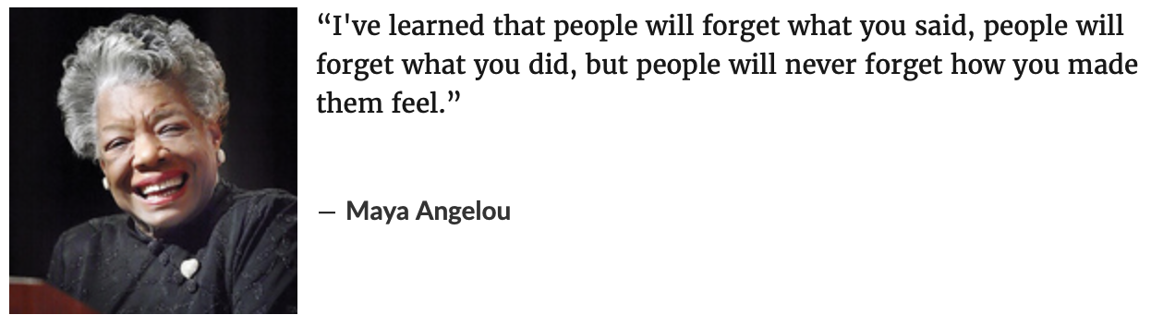
Why the service elements of the mix are so important…

Slide 22
Summary
Most ‘products’ have a ‘service’ element.
The service element is highly influential in the management of customer satisfaction and repeat purchase.
Often ignored because of its characteristics of intangibility and perishability.
Its value within the mix is difficult to measure but makes an essential contribution to customer satisfaction

